Slide 1
Model
Deployment
Shahriar’s Analytical Academy

Slide 2
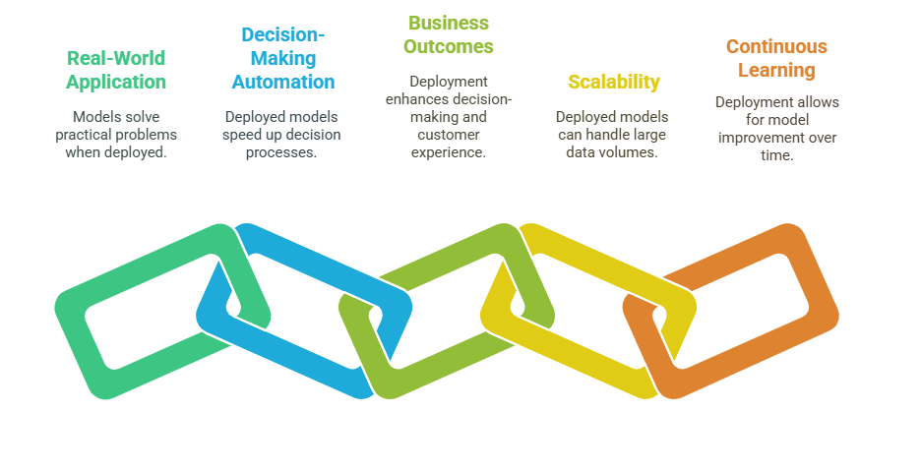
Model Evaluation
Model deployment refers to the process of making a machine learning model available for use in a production environment. It involves taking a trained model and integrating it into an existing system where it can process real-world data and provide predictions or recommendations.
Notes:
Model deployment is the process of taking a machine learning model that has been trained and making it available for use in a real-world environment. Once a model is trained using historical data, it needs to be put into action, allowing it to process live data and provide predictions or insights. This step involves integrating the model into an application or system where it can interact with users or other systems. For instance, a model that predicts the likelihood of loan approval might be deployed into a banking system to automatically assess loan applications.
Importance of Model Deployment
Real-World Application: The primary aim of creating machine learning models is to solve practical problems. However, a model is only useful once it is deployed in the real world. This deployment allows the model to make decisions, assist users, or automate processes, thus having a direct impact on business operations.
Automates Decision-Making: Once deployed, the model can make decisions automatically, which reduces the need for manual intervention. This leads to faster decision-making and helps businesses scale their operations efficiently.
Improves Business Outcomes: Deployed models provide businesses with predictive insights that can improve decision-making. For example, a customer segmentation model can help a business tailor its marketing strategies, thereby enhancing customer engagement and increasing sales.
Scalability: Deployment allows the model to scale according to the volume of data it needs to process. This is particularly important for large businesses that need to handle big data, ensuring that the model can continue to perform well as the amount of data grows.
Continuous Learning: After deployment, the model can continue to improve over time. By monitoring its performance and feeding it new data, businesses can retrain the model, which helps it stay accurate and relevant in an evolving environment.

Slide 3
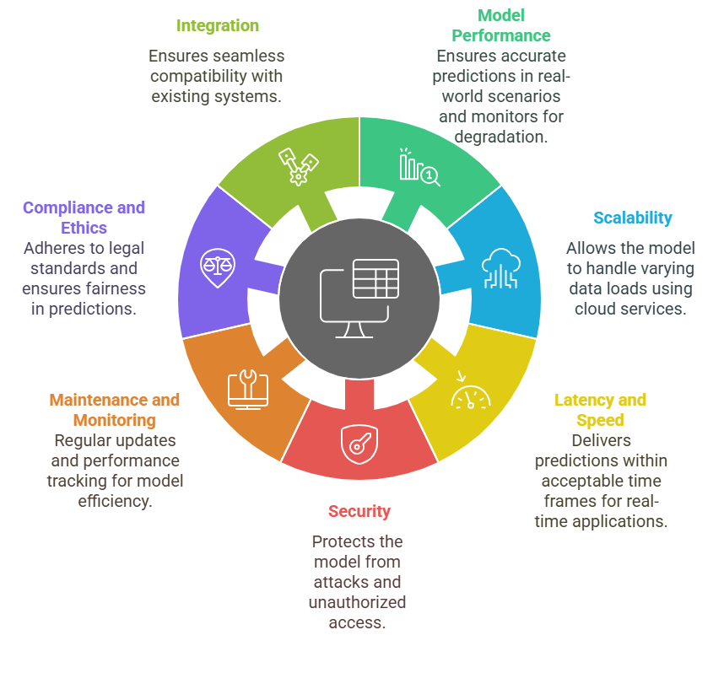
Key factors to
consider
Notes:
Key Factors to Consider:
Model Performance: The model must perform well not just on training and testing data but also in the real-world environment where it will be used. It should provide accurate predictions and make decisions that align with business needs. Regular performance monitoring is necessary to detect and address any performance issues over time.
Scalability: As businesses grow, the system needs to handle larger volumes of data and more users. The deployed model should be scalable, meaning it should be able to process larger datasets or respond to more requests without a significant drop in performance. Cloud services like AWS and Azure are often used for scalable deployments.
Latency and Speed: In some cases, especially in time-sensitive applications, the model must provide predictions quickly. For example, fraud detection systems need to evaluate transactions in real time. Therefore, minimizing latency and ensuring fast responses is crucial for such applications.
Security: Protecting a deployed model from threats is essential. This includes securing the data that flows into the model, ensuring that only authorized users can access the model, and preventing model theft or tampering. Using encryption and implementing access controls can help secure the deployment.
Maintenance and Monitoring: Once deployed, the model needs continuous monitoring to ensure that it continues to deliver accurate predictions. Maintenance might include updating the model with new data, retraining it, or making adjustments based on changes in the business environment.
Compliance and Ethics: The model must adhere to legal, regulatory, and ethical standards. For example, in healthcare, a model might need to comply with HIPAA regulations. Additionally, the model should be free from bias, particularly in sensitive areas like finance or healthcare, where unfair decisions could lead to harmful consequences.
Integration with Existing Systems: The model must be seamlessly integrated into the current infrastructure. Whether it's an API, microservice, or another system, integration should ensure that the model can easily interact with the existing application without causing disruptions or requiring significant changes.

Slide 4
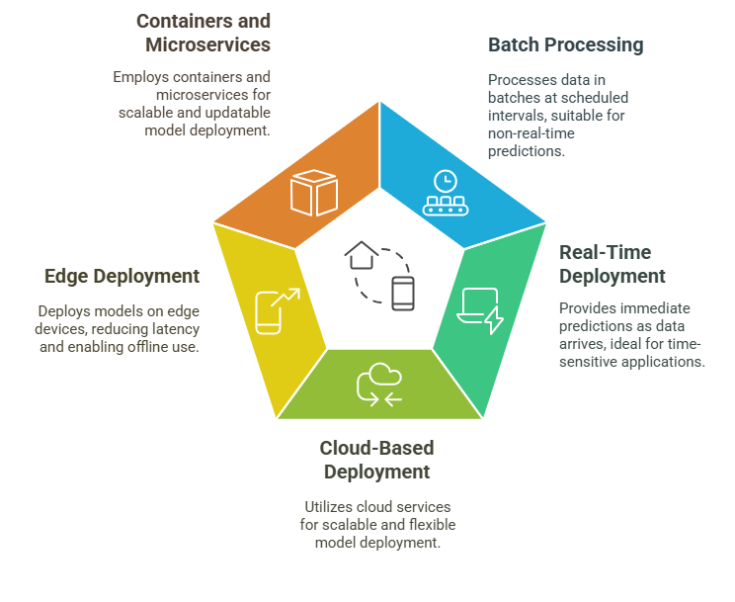
Methods of
Model Deployment
Notes:
Methods of Model Deployment:
Batch Processing: In this method, the model processes data in large chunks at specific intervals, rather than in real-time. This is useful when real-time predictions are not necessary. For example, a model predicting customer churn can run once a day, analyzing all the data gathered in the past 24 hours.
Real-Time Deployment: Real-time deployment involves using the model to generate predictions instantly as new data is received. This is crucial for applications that require immediate decision-making, like fraud detection systems that analyze transactions as they occur to prevent fraudulent activity.
Cloud-Based Deployment: Cloud services like AWS, Google Cloud, and Microsoft Azure allow models to be deployed on scalable cloud infrastructure. Cloud deployment offers flexibility and cost-effectiveness, especially for models that need to scale or require significant computational power.
Edge Deployment: In this method, models are deployed directly on devices such as smartphones or IoT devices. Edge deployment reduces latency because the processing happens locally, without needing to send data to a centralized server. This is particularly useful for applications that need to work offline or in real-time, such as image recognition apps on smartphones.
Containers and Microservices: Models can be deployed using containers, such as Docker, which package the model with everything it needs to run. This approach, combined with microservices architecture, allows the model to scale and be updated independently of other parts of the system, making it easier to maintain and deploy across different environments.

Slide 5
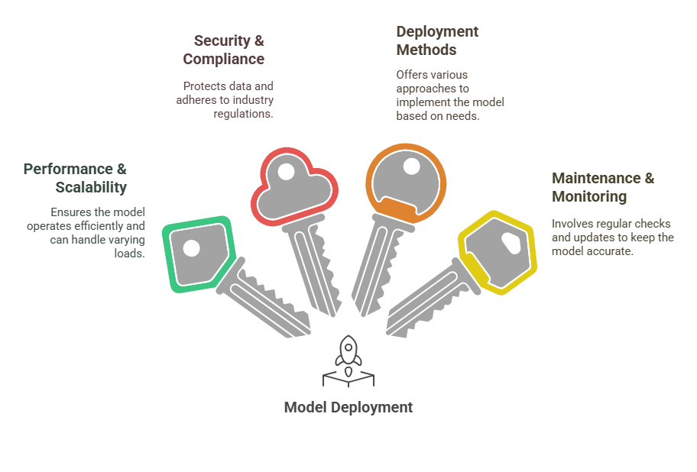
4 Key Learning Points of this Lesson
Notes:
Performance and Scalability Matter: The success of model deployment hinges on factors like performance, scalability, and speed. Ensuring that the model can handle large volumes of data, process predictions quickly, and maintain high performance is crucial for a smooth deployment.
Security and Compliance Should Not Be Overlooked: Deployed models must be secure to protect against data breaches and unauthorized access. Additionally, the model must comply with relevant regulations to ensure ethical use and to avoid legal issues. Security and compliance should be integrated into the deployment process from the start.
Multiple Deployment Methods Are Available: Depending on the application, different deployment methods such as batch processing, real-time deployment, or cloud-based solutions might be appropriate. Each method has its advantages and can be chosen based on the specific requirements of the business or application.
Maintenance and Monitoring are Key for Long-Term Success: Deployment does not end with putting the model into production. Ongoing maintenance, monitoring, and periodic retraining are essential to ensure the model continues to perform well and remains relevant as the business and data evolve.

Slide 6
Thank You!
Shahriar’s Analytical Academy

